Slide 1
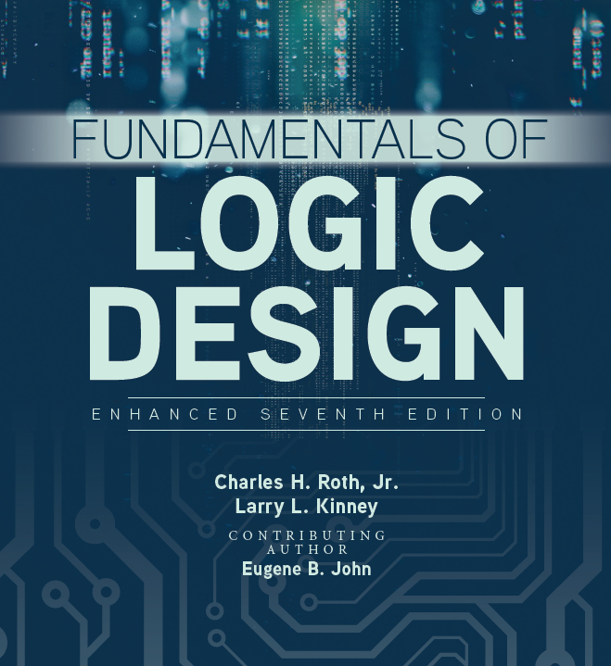

Unit 1
Review

Slide 2

Binary code
Decimal | BCD | Gray Code
0 | 0000 | 0000
1 | 0001 | 0100
2 | 0010 | 0101
3 | 0011 | 0111
4 | 0100 | 0110
5 | 0101 | 0010
6 | 0110 | 0011
7 | 0111 | 0001
8 | 1000 | 1001
Binary-Coded Decimal (BCD) and Gray Code
Determine the minimum number of the digits used to denote the represent a decimal number

Slide 3

Representation of Negative Numbers
3 Systems for representing negative numbers in binary- Overview:
Sign & Magnitude: Most significant bit is the sign
Ex: – 5₁₀ = 1101₂
1’s Complement: = (2^{n} – 1) - N
Ex: – 5₁₀ = (2⁴ – 1) – 5 = 16 – 1 – 5 = 10₁₀ = 1010₂
2’s Complement: N* = 2^{n} - N
Ex: – 5₁₀ = 2⁴ – 5 = 16 – 5 = 11₁₀ = 1011₂

Slide 4
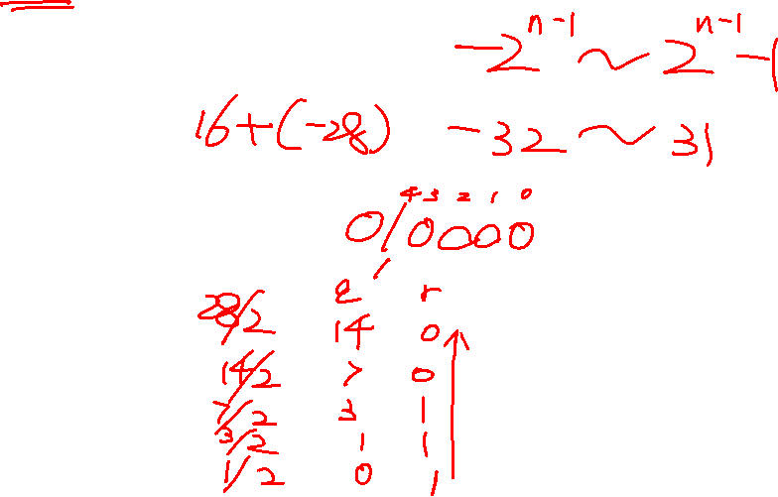
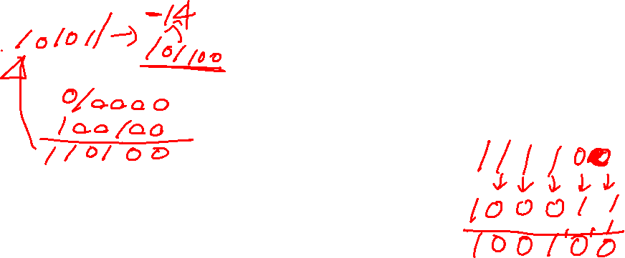
Binary addition and subtraction
Use 6 digits to denote the binary number (n=6). What is the range of the decimal number can be denoted?
compute 16-28
compute -15-10
compute 18+16

Slide 5
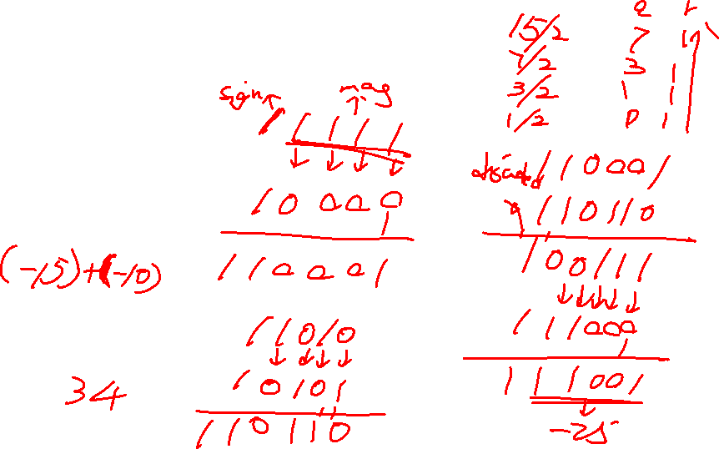
Binary addition and subtraction
Use 6 digits to denote the binary number (n=6). What is the range of the decimal number can be denoted?
compute 16-28
compute -15-10
compute 18+16

Slide 6
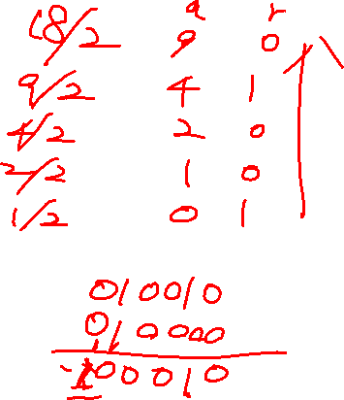
Binary addition and subtraction
Use 6 digits to denote the binary number (n=6). What is the range of the decimal number can be denoted?
compute 16-28
compute -15-10
compute 18+16

Slide 7
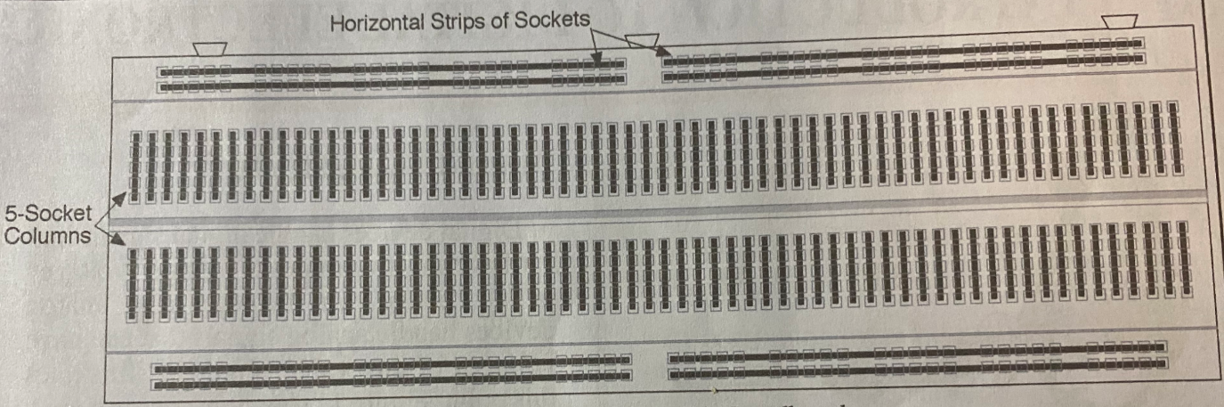
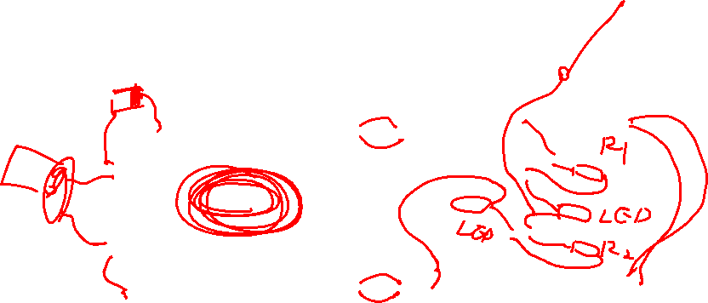

Slide 8
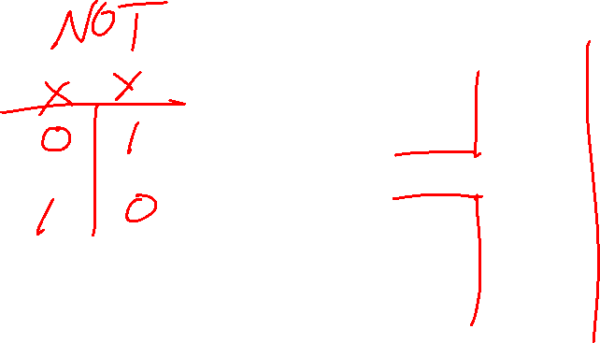
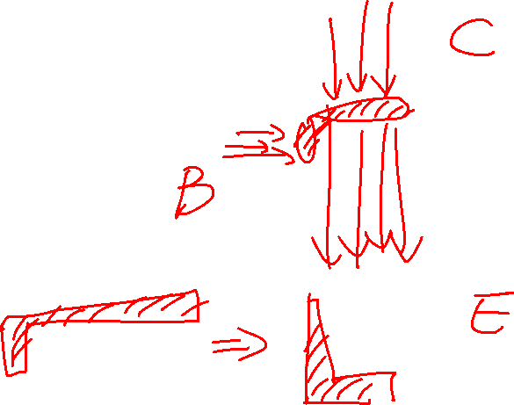

Slide 9
